Slide 1
Visual Programming SOLD PRINCIPLES

Slide 2
Understanding the SOLID Principles in Software Design
Introduction to SOLID Principles
1. Significance of Software Design Principles
Software design principles help developers:
Write clean, maintainable, and scalable code.
Make software robust against changes.
Avoid code smells, such as tight coupling or poor cohesion.
Enhance testability and reuse.

Slide 3
What is SOLID?
SOLID is an acronym for five core principles:
S: Single Responsibility Principle (SRP)
O: Open-Closed Principle (OCP)
L: Liskov Substitution Principle (LSP)
I: Interface Segregation Principle (ISP)
D: Dependency Inversion Principle (DIP)

Slide 4
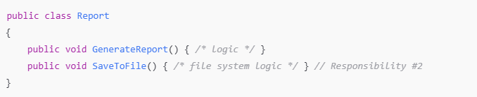
1. Single Responsibility Principle (SRP)
Definition
A class should have only one reason to change, meaning it should only have one job or responsibility.
SRP Violation Example
Problem: Report class is responsible for both report generation and file storage.

Slide 5
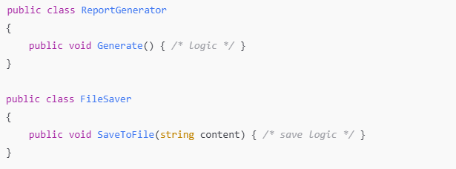
1. Single Responsibility Principle (SRP)
SRP-Compliant Code

Slide 6
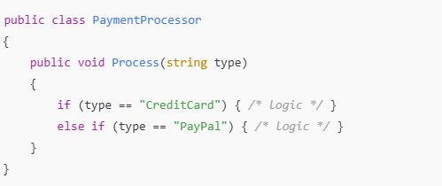
2. Open-Closed Principle (OCP)
Definition
Software entities (classes, modules, functions, etc.) should be open for extension but closed for modification.
Use abstractions and polymorphism to extend behavior without changing existing code.
OCP Violation

Slide 7
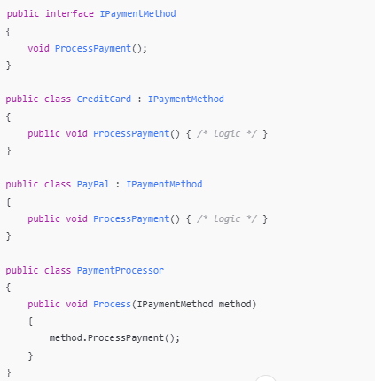
2. Open-Closed Principle (OCP)
OCP-Compliant Code

Slide 8
3. Liskov Substitution Principle (LSP)
Definition
Subtypes must be substitutable for their base types without breaking the functionality.
The Liskov Substitution Principle (LSP) is a fundamental principle in object-oriented programming that states that objects of a superclass should be able to be replaced with objects of a subclass without affecting the correctness of the program. This principle is named after Barbara Liskov, who first formulated it in a 1987 paper.

Slide 9
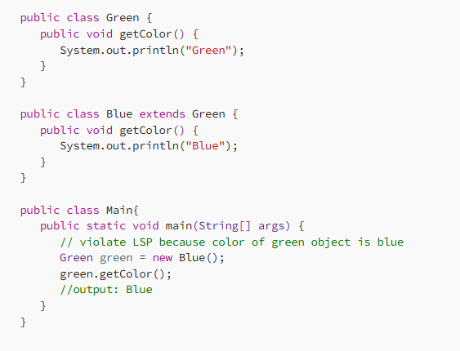
Example 1: LSP
Here, Green is a base super class of Blue. When a new object of Blue will be assigned in object of Super class, getColor() of Green will be replaced by getColor() of Blue according to inheritance rules of OOP. In this situation, we are expecting “Green” color from Green class but we are getting “Blue” color from Green color. So the design of class is violating the LSP.
In the main method, green object is asking for color but it’s getting “Blue” color. How to solve the issue. See the solution in the next slide.

Slide 10
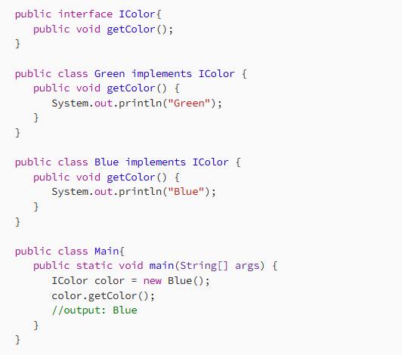
Solution of LSP Violation

Slide 11
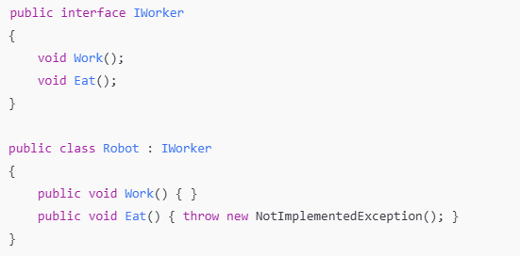
4. Interface Segregation Principle (ISP)
Definition
The Interface Segregation Principle (ISP) suggests that a class should not be forced to implement methods it doesn’t need. In other words, a class should have small, focused interfaces rather than large, monolithic ones. This helps to avoid unnecessary dependencies and ensures that classes only implement the methods they actually need.
ISP Violation

Slide 12
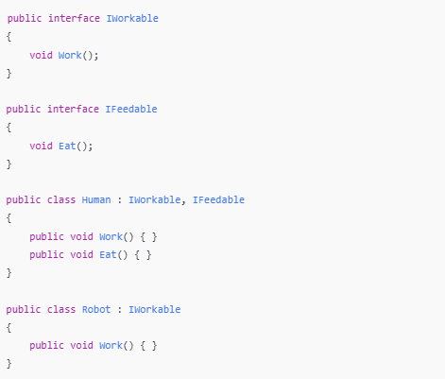
4. Interface Segregation Principle (ISP)
Solution

Slide 13
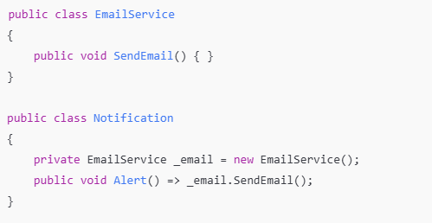
5. Dependency Inversion Principle (DIP)
How is DIP violated?
Notification directly depends on a concrete class, EmailService.
There's no abstraction (like an interface) between them.
This tight coupling means:
You cannot easily swap out EmailService for something else (e.g., SmsService, MockEmailService for testing).
You cannot reuse or extend the Notification class in different contexts without modifying it.
Definition
High-level modules should not depend on low-level modules. Both should depend on abstractions.
Use Dependency Injection (DI) to implement this principle.
DIP Violation

Slide 14
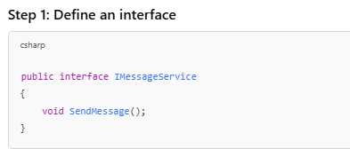
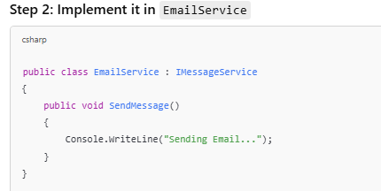
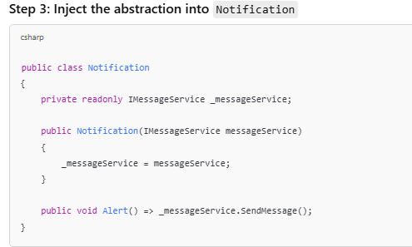
DIP-Compliant Code
Introduce an interface (abstraction) that EmailService implements, and inject it into Notification.

Slide 15
Comparison
Original Design | DIP-Compliant Design
Tight coupling (Notification depends on EmailService) | Loosely coupled (Notification depends on IMessageService)
Hard to change notification method | Easy to extend (add SMS, push notifications, etc.)

Slide 16
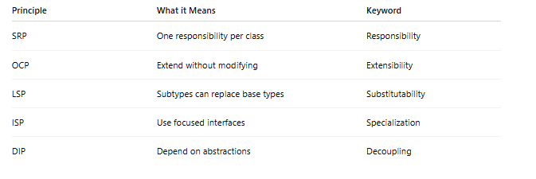
Summary

